Slide 1


Smart Home for the Elderly
Our project aims to create a smart home system designed to enhance the quality of life for the elderly by leveraging innovative digital systems and microcontroller technologies, the project explores practical solutions to common challenges faced by aging individuals, promoting independence, safety, and comfort in their living environment.
By - Team 8
Inesh Dheer (2023111010)
Shreyas Mehta (2023101059)
Kushal Mangla (2023101026)
Sanyam Agrawal (2023101038)

Slide 2
Motivation: Digital Systems and Smart Home Trends
1
Unique Problem Statement
2
Emerging Smart Home Trend
This problem required us to think in a different way and connect what we learned about state diagrams from the DSM (Digital Systems and Microcontrollers) course in order to solve the real-world challenges faced by the elderly.
The growing trend of smart home technologies presents an opportunity to develop innovative solutions that can significantly improve the lives of the elderly, enabling them to live independently and safely in their own homes.

Slide 3
Implementation: Smart Lighting and Fall Detection
Smart Lighting System
Fall Detection System
The project includes a smart lighting system that utilizes a PIR (Passive Infrared) sensor to automatically detect motion and adjust the lighting accordingly, providing convenience and energy efficiency for the elderly user.
A fall detection system is implemented using an MPU 6050 (Inertial Measurement Unit) sensor to monitor the user's movements and detect potential falls, triggering timely alerts to caregivers or emergency services.

Slide 4

Smart Lighting System: Illuminating the Future
Our smart lighting system, is designed to enhance comfort and convenience in homes. With intelligent controls and customizable settings, Say goodbye to manual adjustments and embrace the future of lighting automation.

Slide 5



Fall Detection Monitoring and Alerts
Sensor Monitoring
Alert Triggering
Caregiver Response
The MPU 6050 sensor continuously monitors the elderly user's movements, detecting any sudden changes or sudden impacts that may indicate a fall.
When a potential fall is detected, the system immediately triggers an alert, notifying caregivers or emergency services to provide timely assistance.
Caregivers are able to quickly respond to the alert, assess the situation, and provide the necessary medical attention or support to the elderly user.

Slide 6

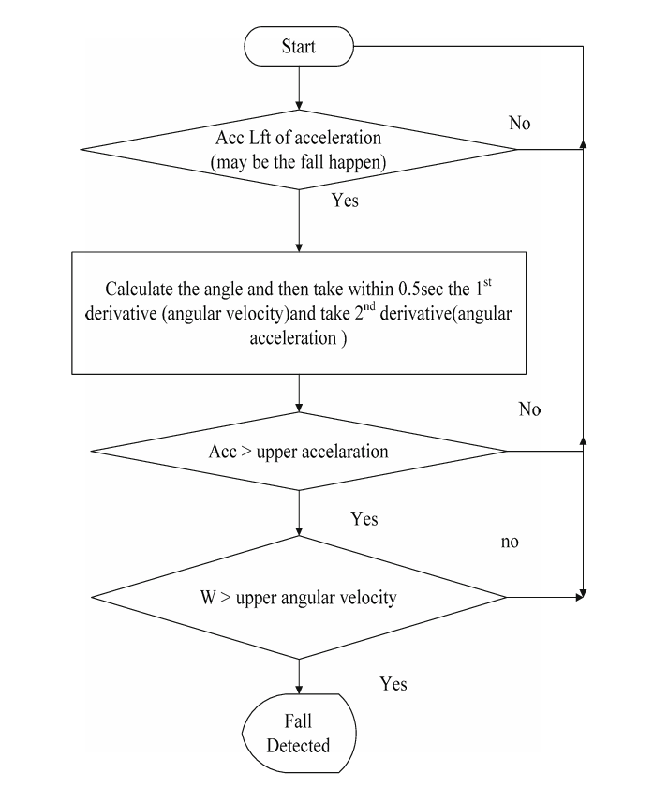
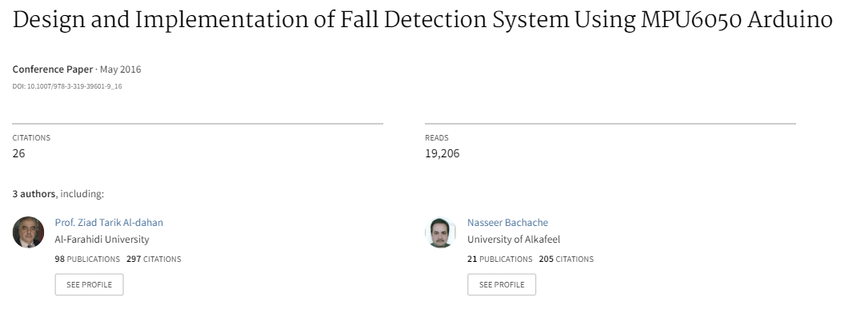
Logical Flowchart
We implemented the concept of sequential states which we learnt back in the DSM course and set thresholds at each level of block logic.
Reference:

Slide 7

Data Collection: Sensors and Analysis
Our data collection process involved using sensors to gather important information. We had initially sent the raw data readings to ThingSpeak Channel.
We developed a Python script to collect raw data from ThingSpeak channel and did computations on the raw data to calculate the Statistical values for data analysis(mean,standard deviation,max,min) which was then used to set suitable thresholds, we conducted multiple rounds of data analysis to calculate final thresholds for angular acceleration and linear acceleration for fall detection in different scenarios to cancel the noise in the readings. We concluded that this meticulous approach ensures accurate monitoring and reliable fall detection in our smart home system.
Took motivation for setting up the cool down time for the automatic lighting subsystem which includes the usage of calibration of the PIR sensor

Slide 8
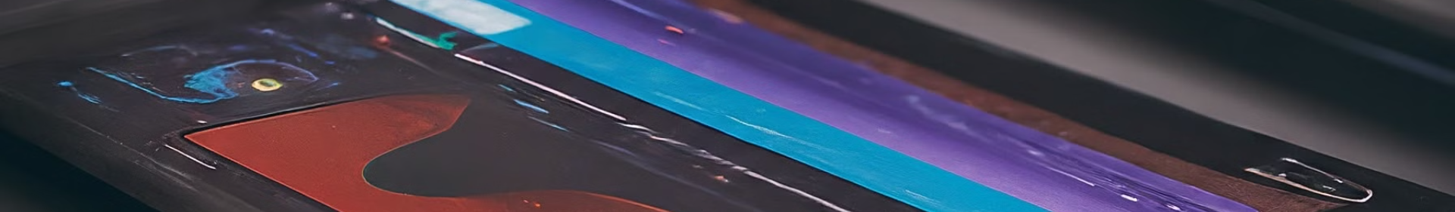
Data Analysis using ThingSpeak
Data Collection
1
Sensor data from the smart lighting and fall detection systems is continuously collected and transmitted to the ThingSpeak cloud platform.
2
Data Analysis
The ThingSpeak platform provides intuitive data visualization tools, enabling the analysis of sensor data and trend patterns to monitor the elderly user's activity and safety.
Actionable Insights
3
The analyzed data is used to generate real-time alerts, trigger appropriate actions, and provide valuable insights to caregivers, empowering them to respond promptly to the elderly user's needs.

Slide 9

Graphical Analysis

Slide 10
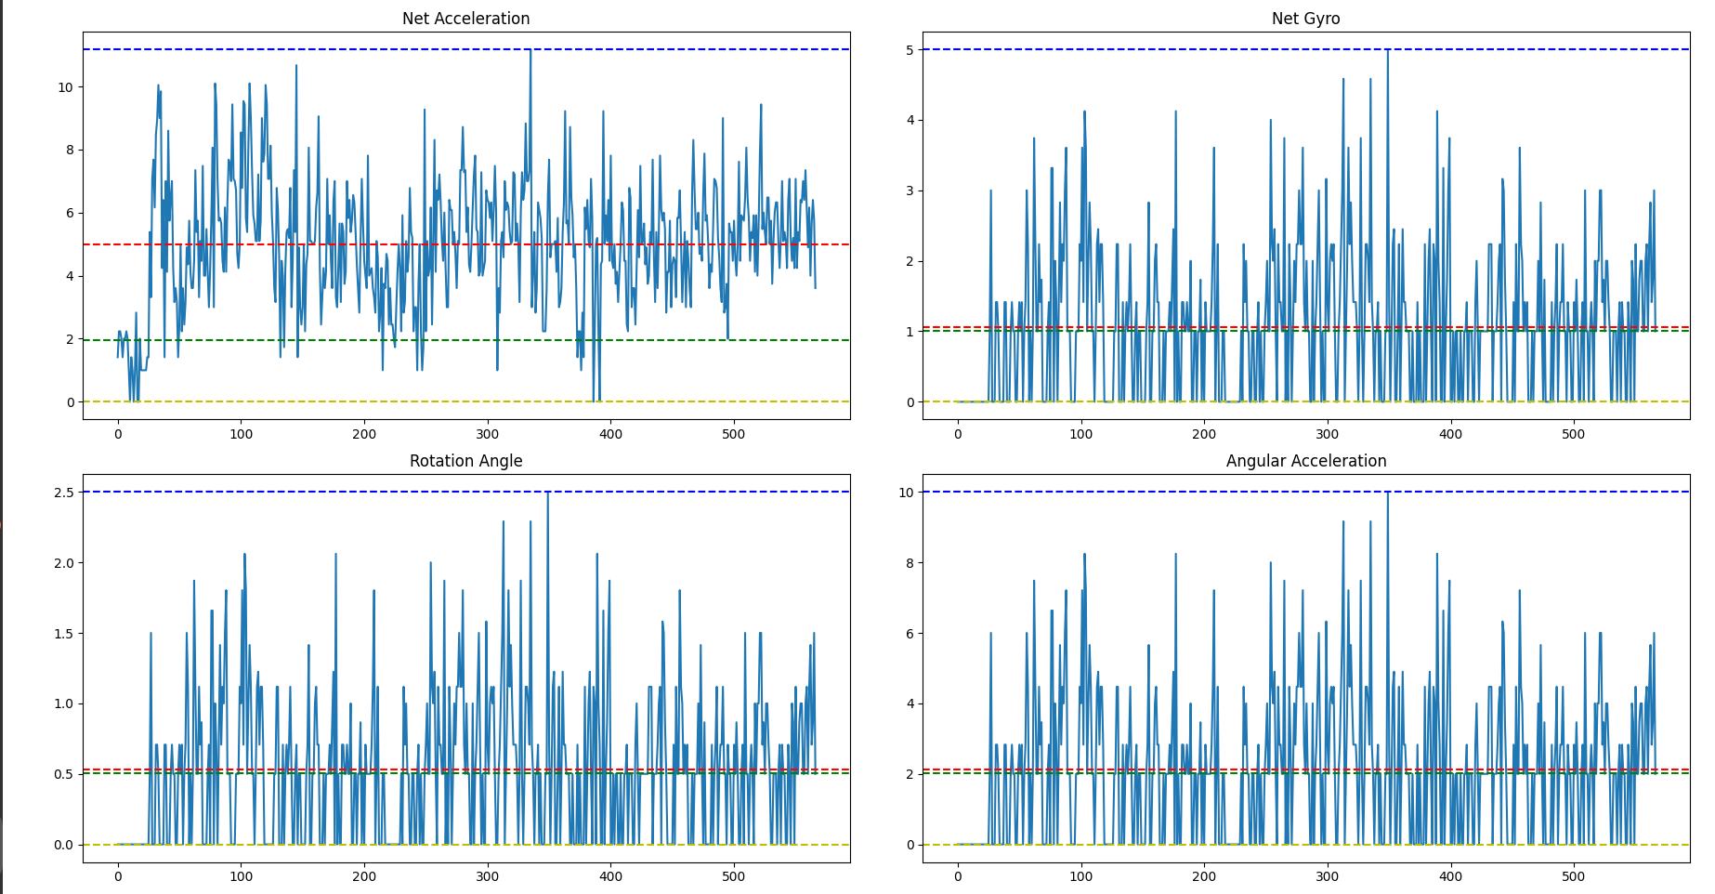
Walk Final

Slide 11
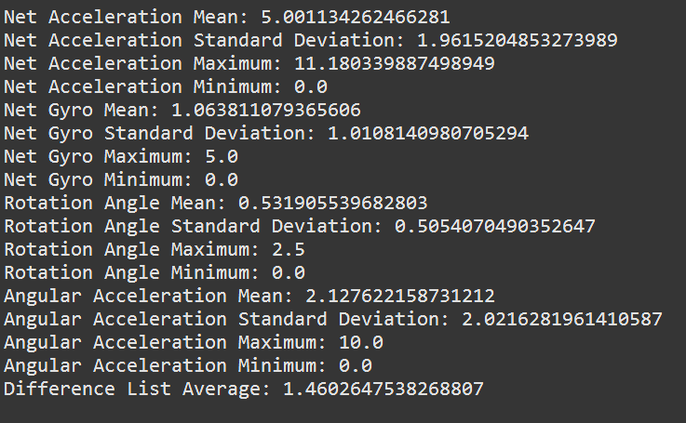
Walk Final Data Computations from Raw Data

Slide 12
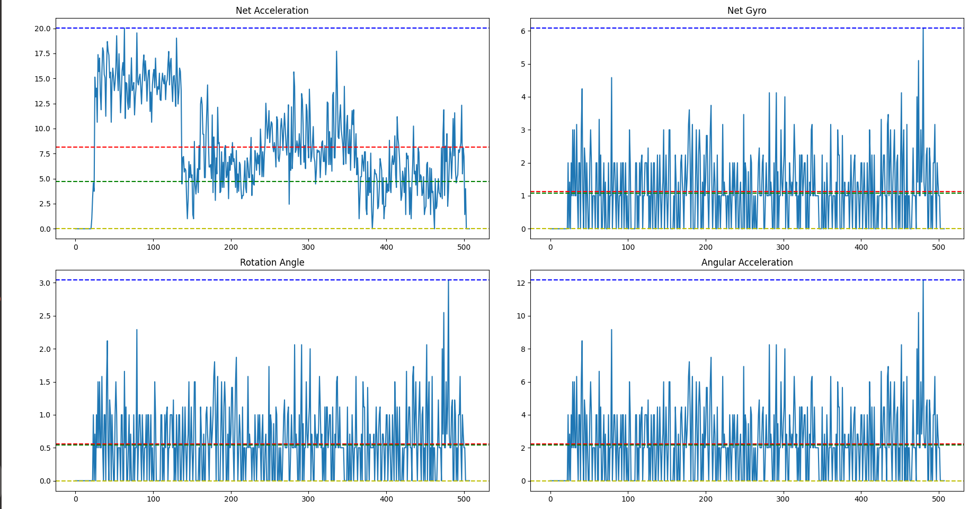
Run Final

Slide 13
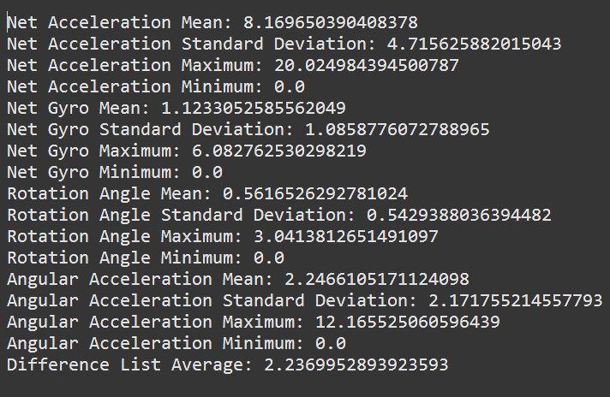
Run Final Data Computations from Raw Data

Slide 14
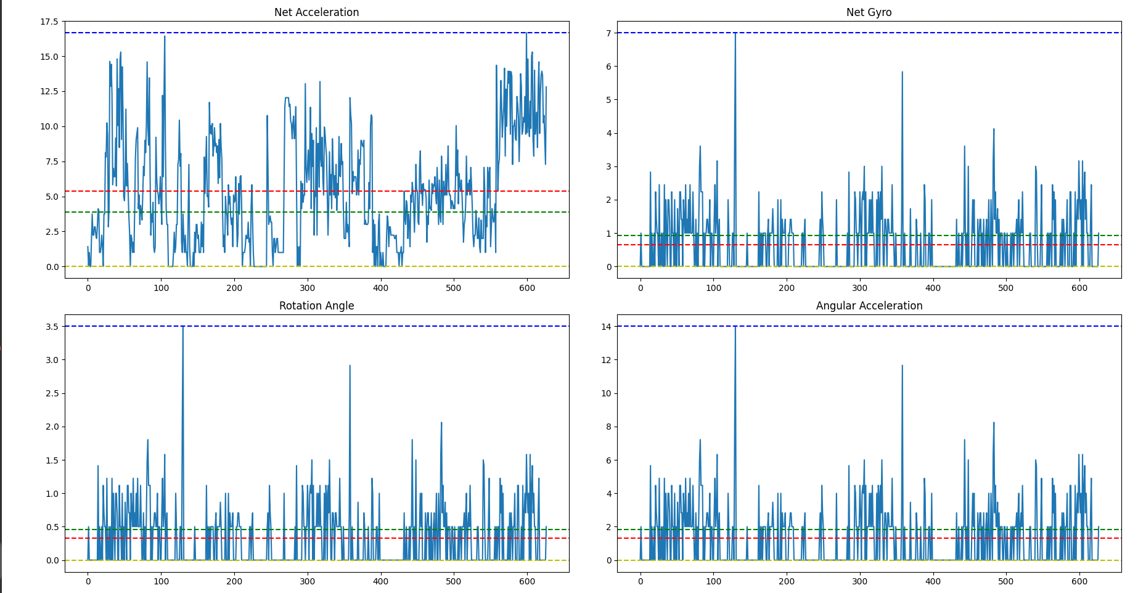
Upstairs Final

Slide 15
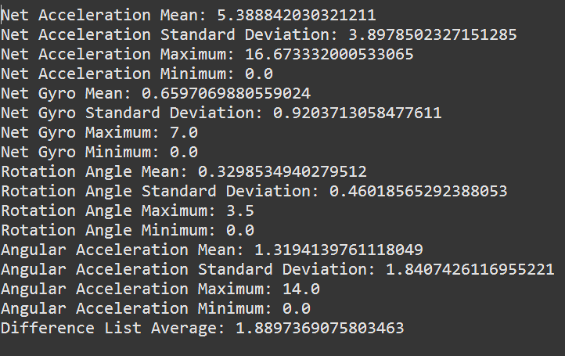
Walk Upstairs Final Data Computations from Raw Data

Slide 16
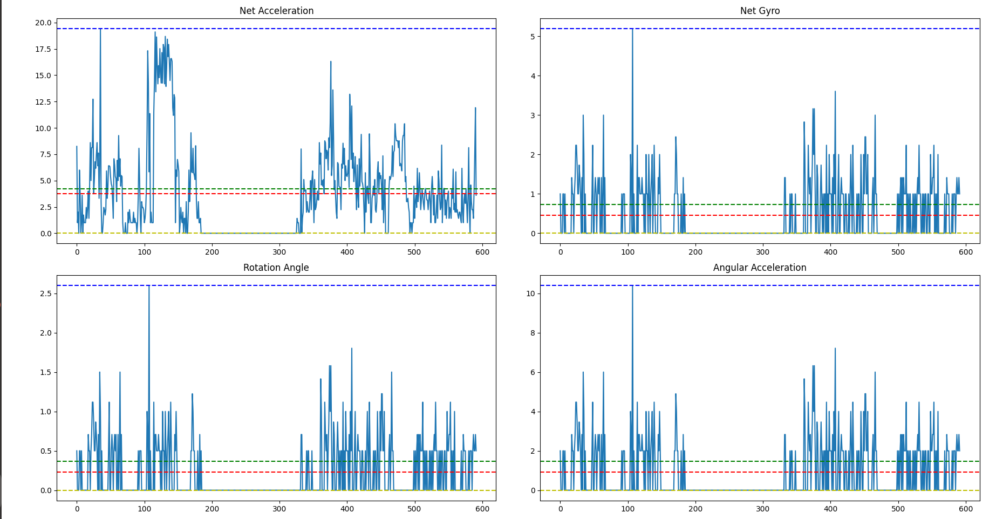
Downstairs Final

Slide 17
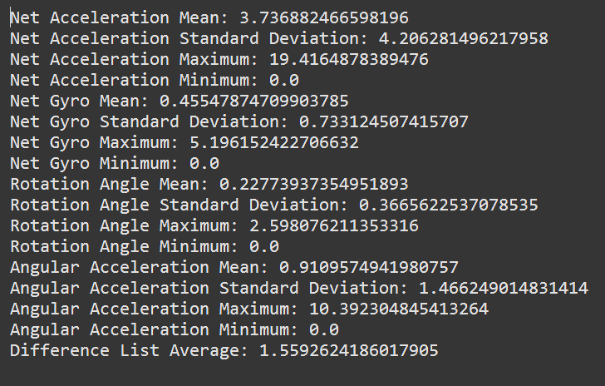
Walk Downstairs Final Data Computations from Raw Data

Slide 18

Challenges in Data Collection
During the data collection phase, we encountered several challenges. Limited data and time constraints prevented us from exploring exhaustive scenarios. Additionally, the PIR sensor was initially too sensitive, but we addressed this issue by adding side plates. Data collection for the fall detection system was done in intervals, so ThingSpeak channel data had to be cleared and the data had to be collected daily which was a tedious task.

Slide 19
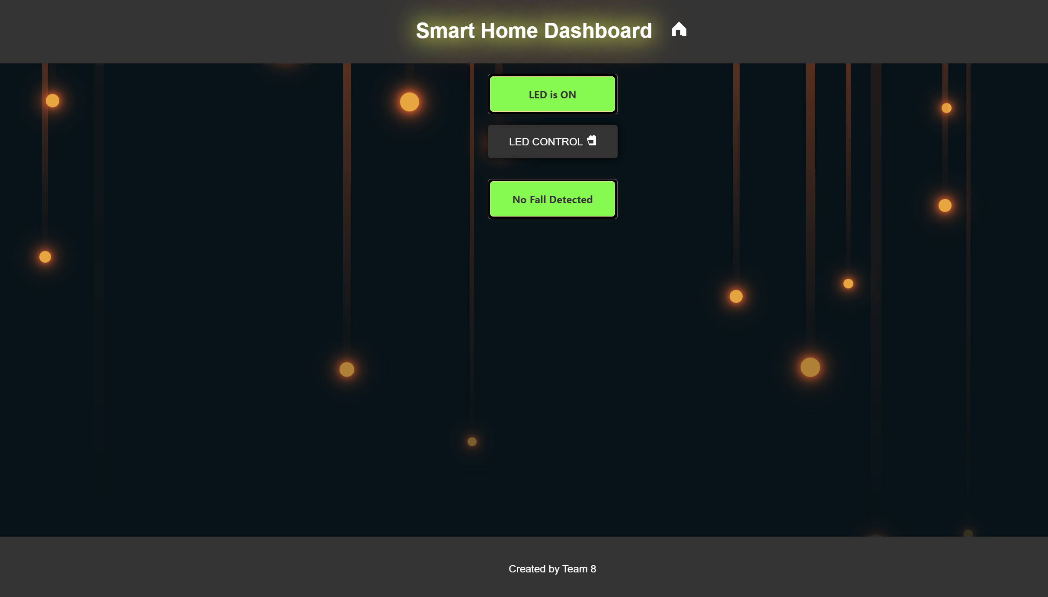

Slide 20

Scalable and Adaptive
The MPU is a miniature sensor which costs around 300 rupees and it can be attached to the finger of the elderly person. We have created 4 scenarios on the basis of which we are categorizing the current state of the person and hence we figure out the thresholds on the basis of the pre defined set of values, if we are able to implement a feedback system (using the activity detection system which we have already implemented in our fall detection subsystem), which will help us to dynamically update the thresholds then we can call this an adaptive solution which will help in the monitoring of the routine of the person. We can also label this to be a scalable solution as the costs incurred while making this project were quite minimal and if the dashboard is once hosted then we will have a working Edge-Node architecture and multiple devices can monitor the fall detection if they subscribe the respective channel through ThingSpeak.

Slide 21
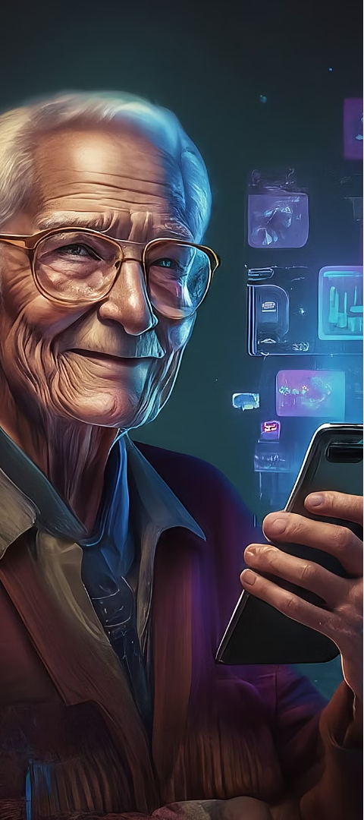
Conclusion and Future Scope
Improved Quality of Life
Expanding Capabilities
The integration of smart home technologies, such as the smart lighting and fall detection systems, empowers the elderly to live more independently and safely in their own homes, enhancing their overall quality of life.
Future developments may include incorporating additional sensors, integrating voice control, and expanding the data analysis capabilities to provide even more comprehensive support for the elderly and their caregivers.

